Slide 1

Travel System Analysis
Ishant chouhan

Slide 2

Software used
Power BI
for data visualizaion
Excel
for data cleaning /managing

Slide 3

What is Power BI?
It is a Business intelligence tool.
It helps in analysing the data and convert it into visual format.
Features:
-Power View
-Power Query
-Power BI Service
-Power Pivot

Slide 4
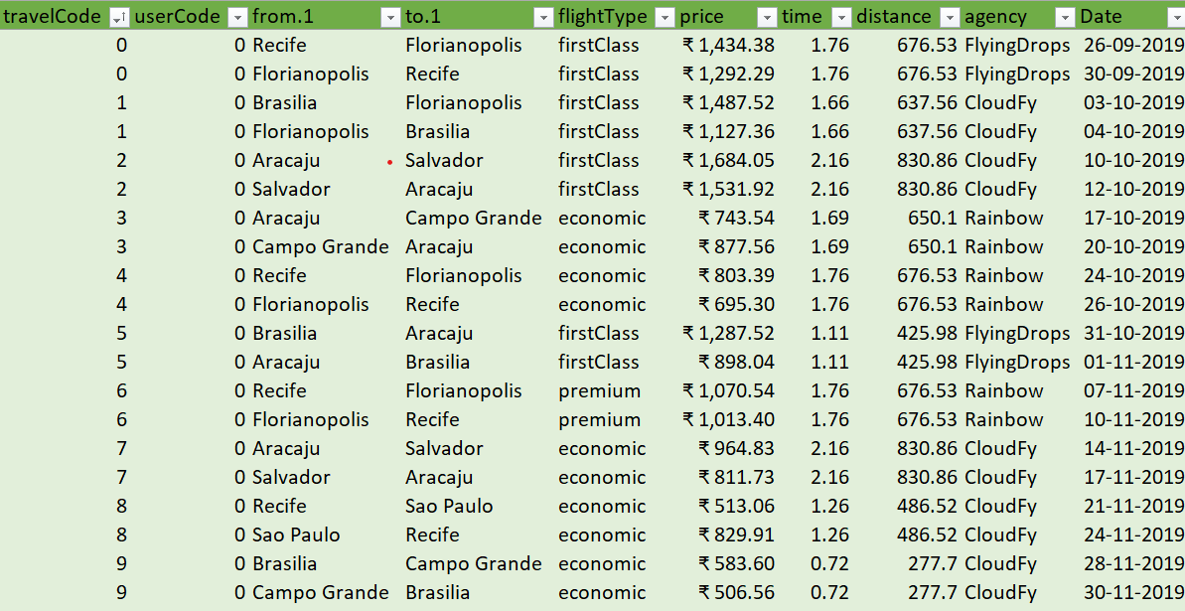
Data Set
It contain information about users who travelled through flights or booked hotels in the last 5 years.
Data set contains 3 tables –
Users
Flights
Hotels

Slide 5

Data Cleaning
It involves Excel and Power Query Editor.
Converted dates into proper format.
Extracted unidentified genders.

Slide 6
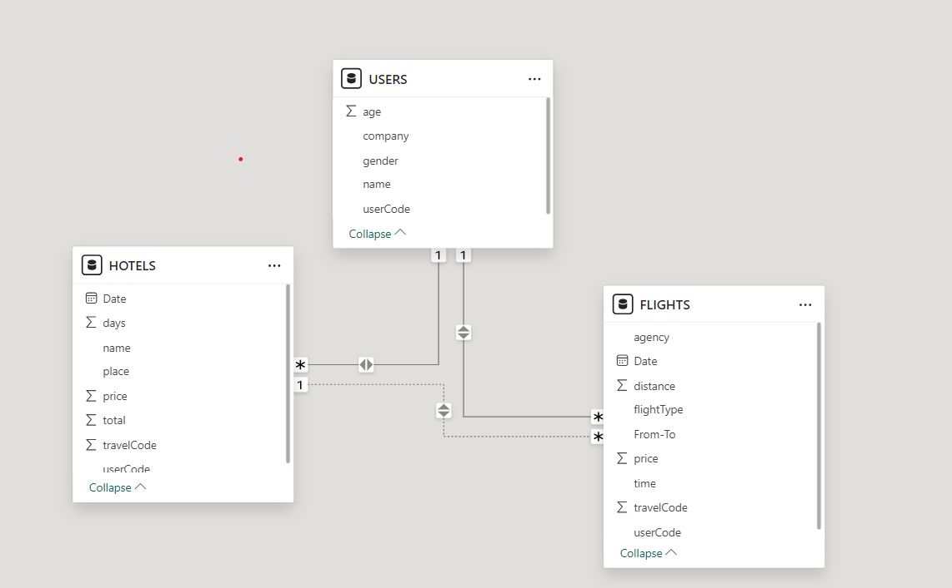
Data Relationship

Slide 7
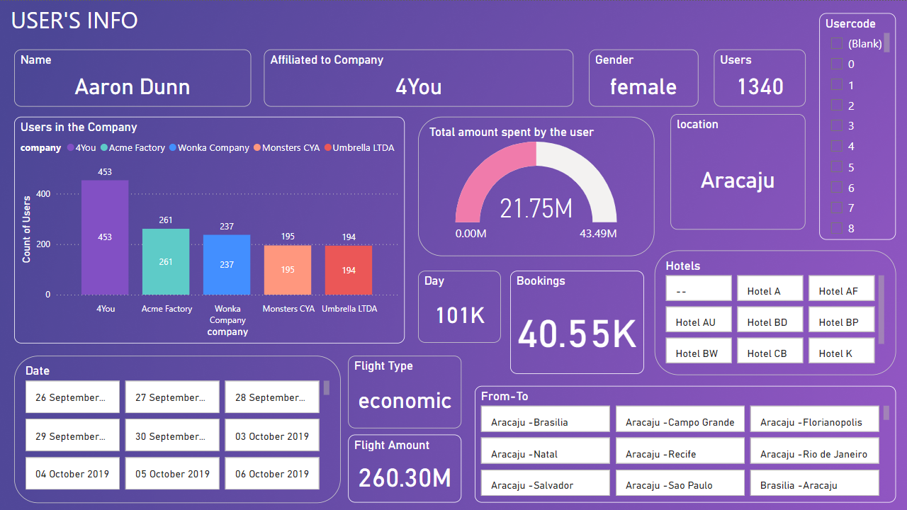
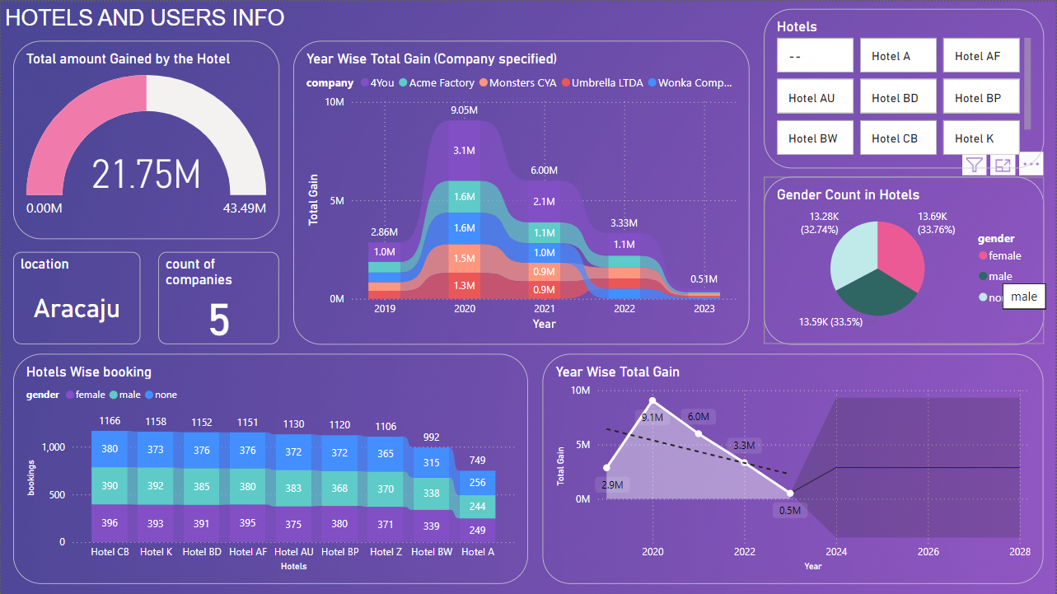
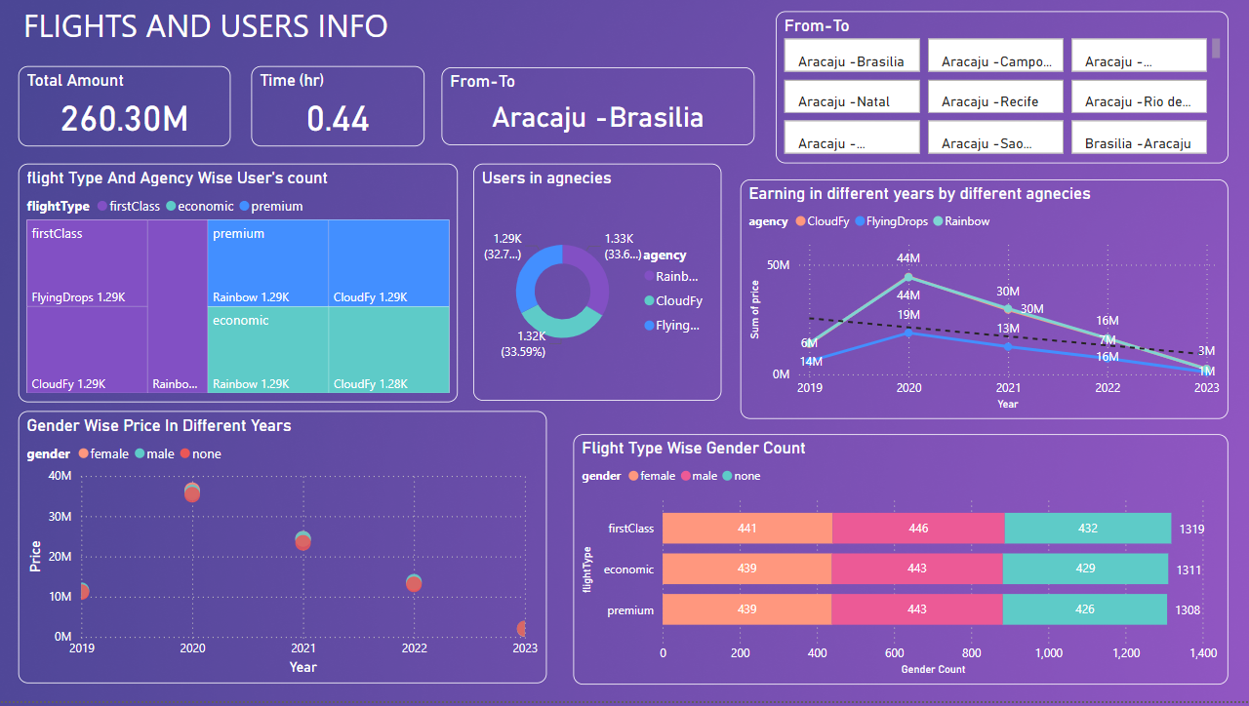
DashBoards

Slide 8
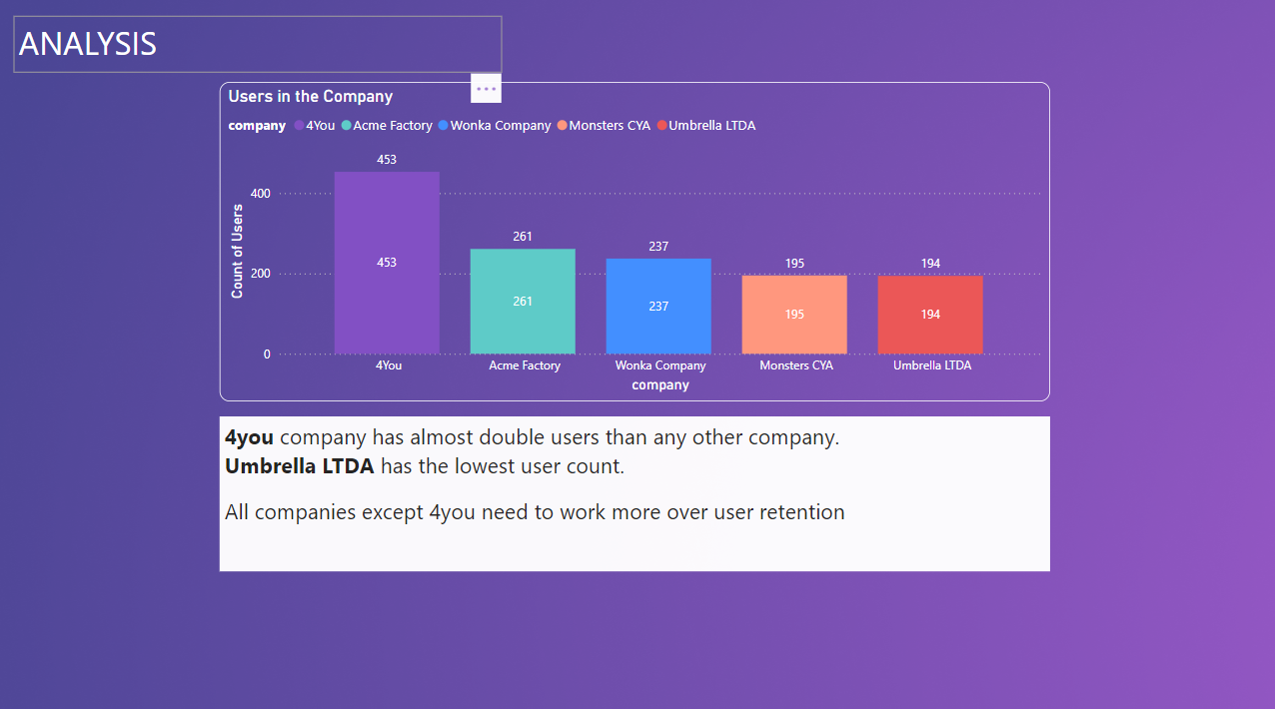
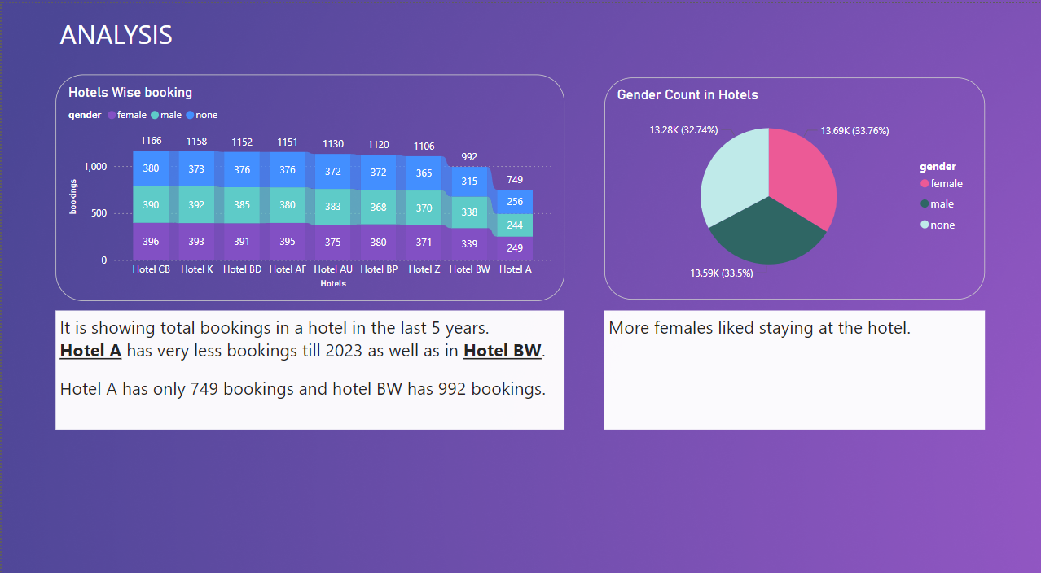
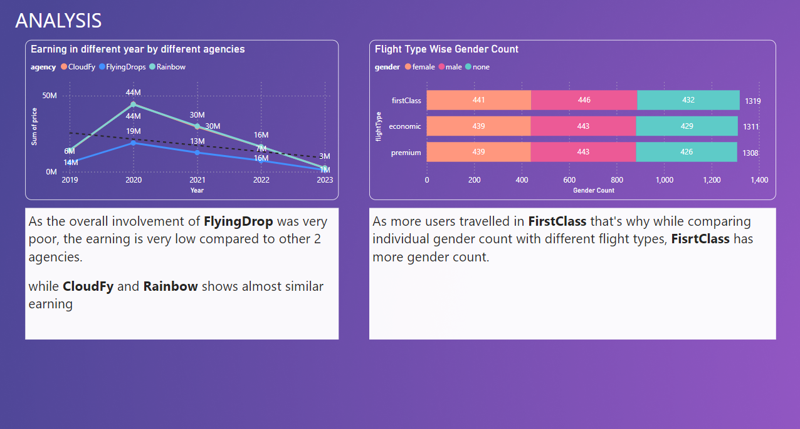
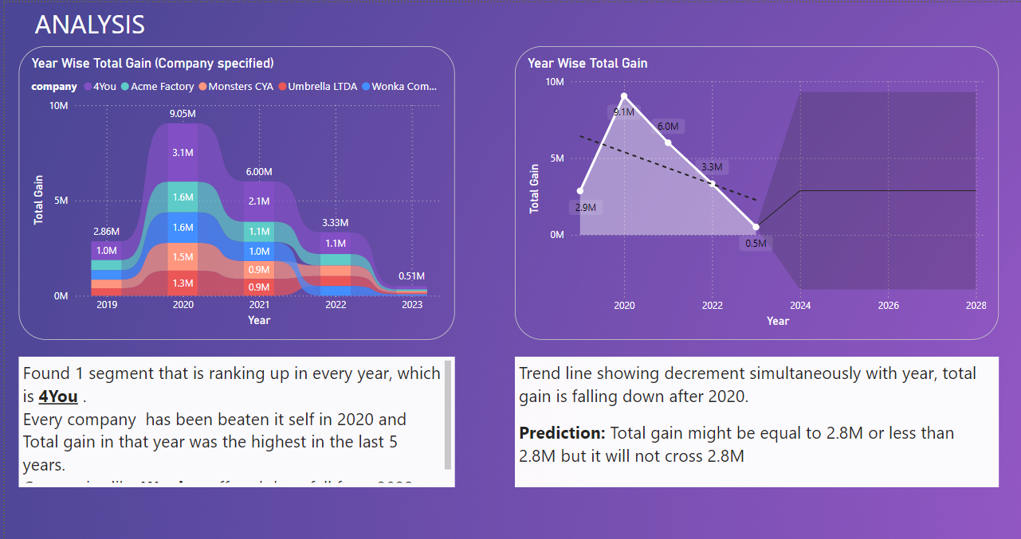
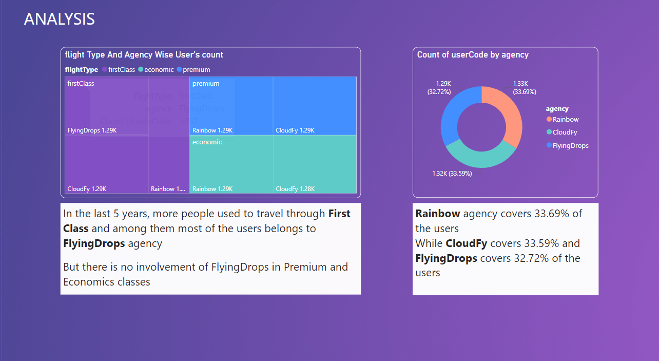
Insights

Slide 9
Thank You
Ishant chouhan

